Slide 1

Machine Learning Predictions for Superconductors
Vasileios Feidantsis ph5320
Grigorios Tersenov mst1996

Slide 2
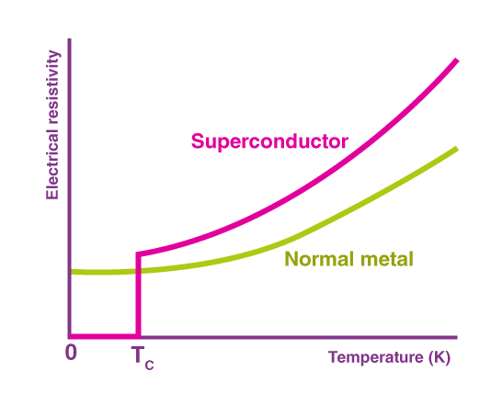
Introduction
Superconductors are materials with zero electrical resistance a certain critical temperature.
This project focuses on predicting critical temperatures and exploring potential high-Tc superconductors.

Slide 3
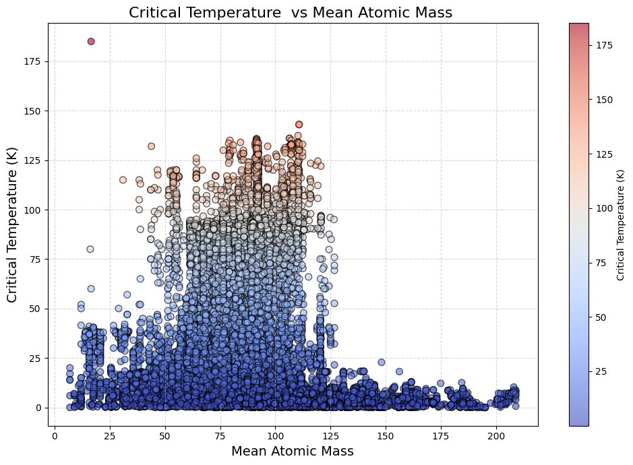
Dataset Overview
File components:
train.csv: includes 82 features describing elemental properties
unique_m.csv: provides detailed compositional data, (fractional presence of each chemical element in a material. )

Slide 4
Sections
1
2
3
4
Model selection
Finding the best best performing model for our dataset
Feature engineering
Which features contribute the most and which ones can be excluded
Anomaly detection
Detecting outliers
Predicting new materials
Finding new combinations of elements with high Tc

Slide 5
1. Model Selection
RMSE comparison for different Regression models:
Model | Linear Regression | K-Nearest Neighbors | Gradient boost | Random Forest | SVR | MLP
RMSE | 17.38 | 10.44 | 12.33 | 9.04 | 15.78 | 10.63
Cross validation RMSE | 17.70 | 11.35 | 12.76 | 9.79 | 16.60 | 11.49
Optimal hyperparameters found for Random Forest:
Parameters : {max_depth=20, min_samples_split=2, n_estimators=300}
With final RMSE: 8.95

Slide 6
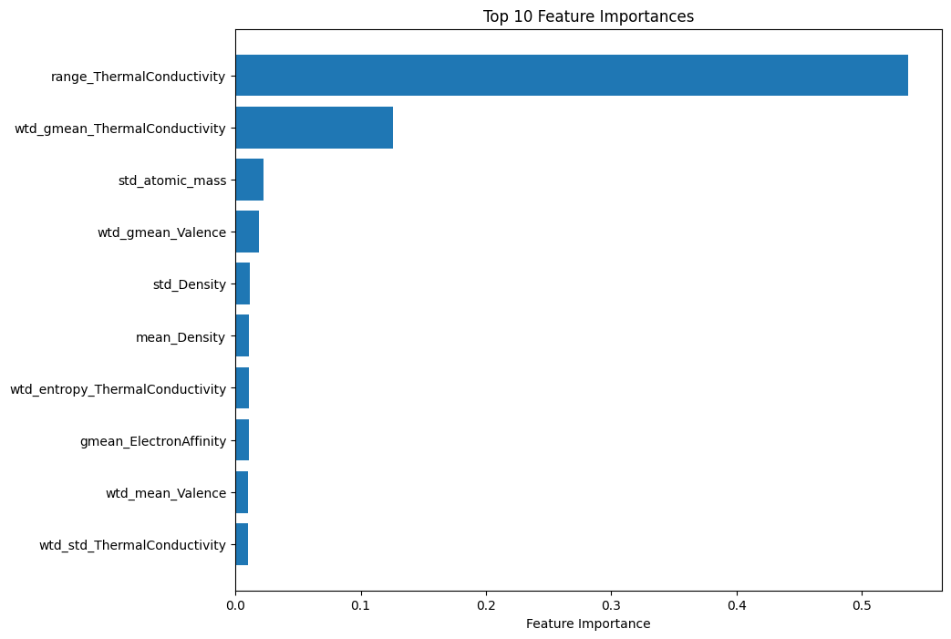
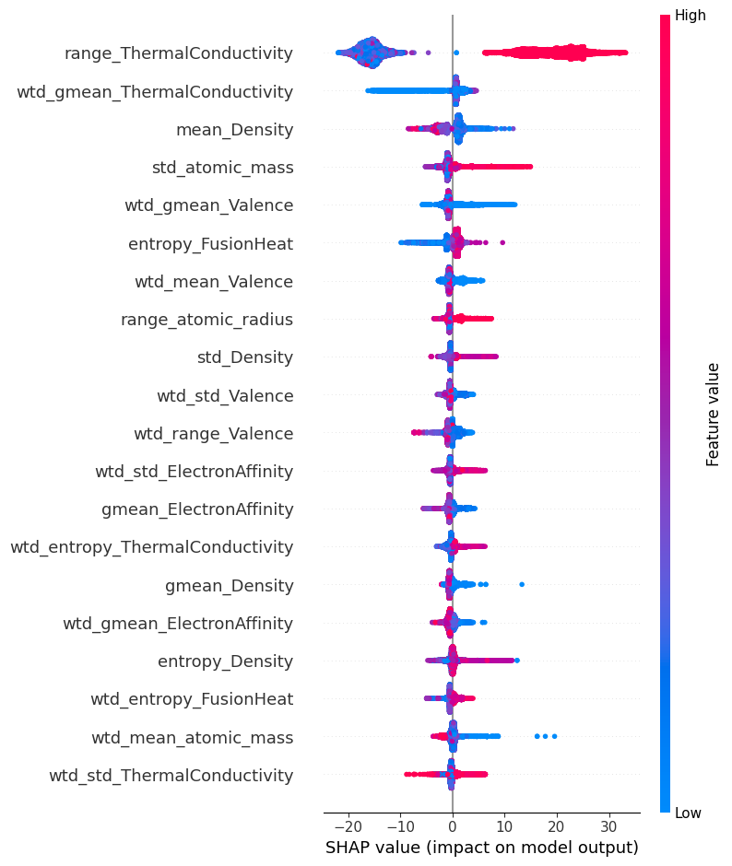
2. Feature engineering
Random Forest’s feature importance:
SHAP feature importance:

Slide 7
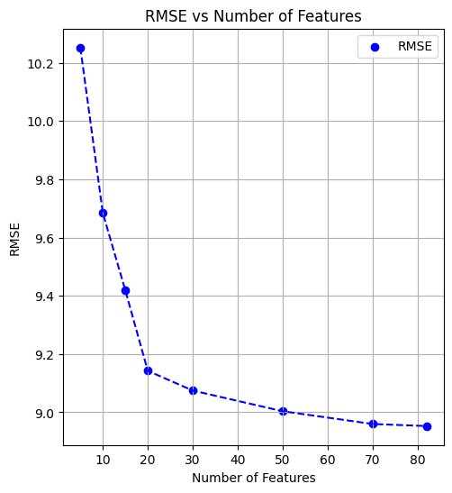
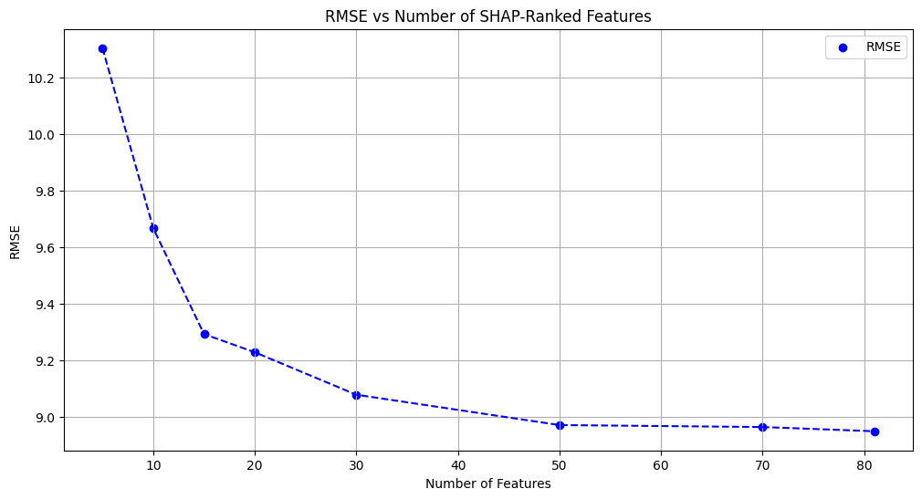
2. Feature engineering
Random Forest’s feature selection:
SHAP feature selection:

Slide 8
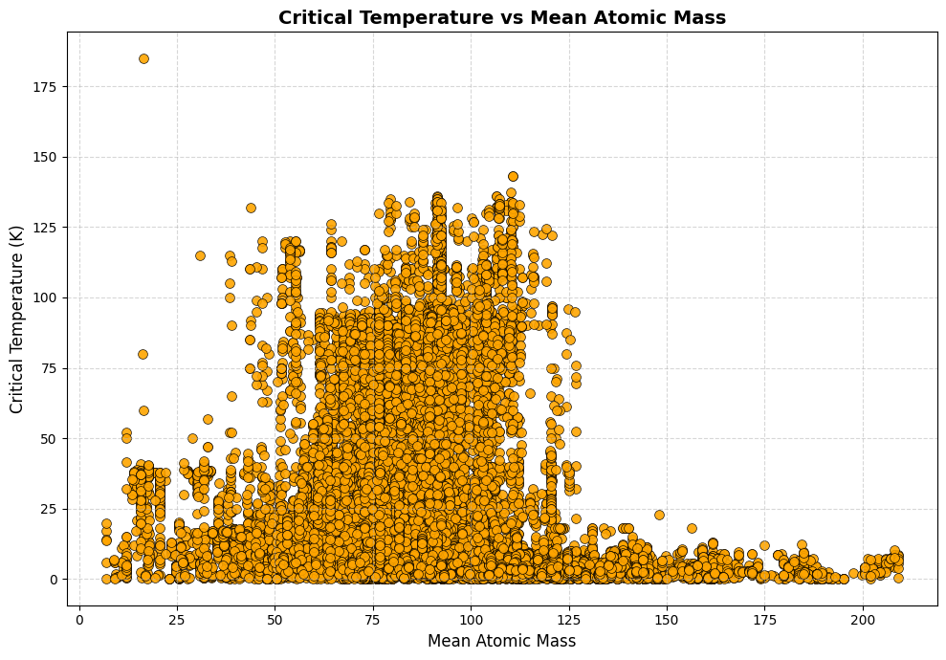
3. Anomaly detection
Based on the plot:
We assume an anomaly ratio of ~1% for both techniques used.
We exclude data points with a critical temperature of 0 K

Slide 9
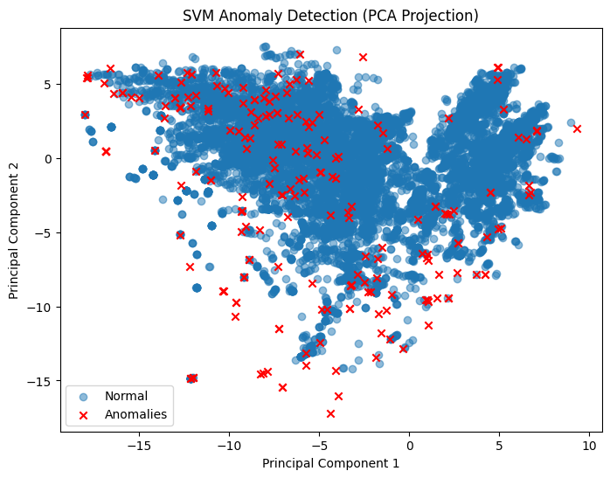
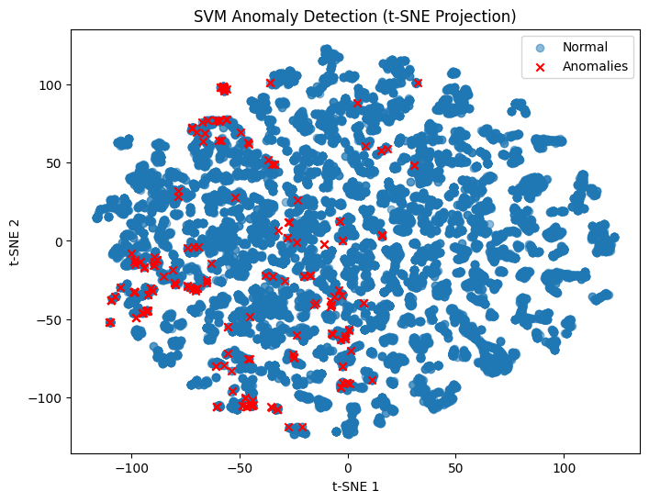
3. Anomaly detection
SVM Approach:
215 anomalies detected

Slide 10
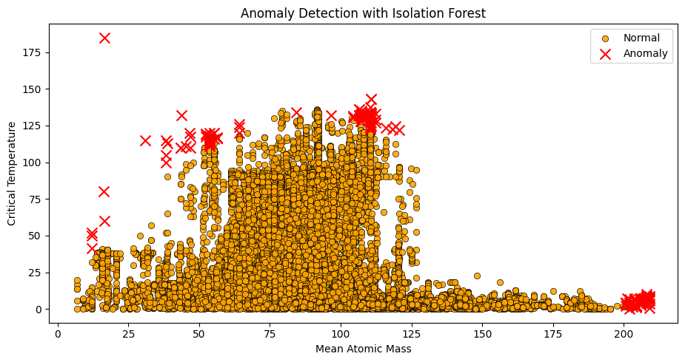
3. Anomaly detection
208-222 anomalies detected

Slide 11
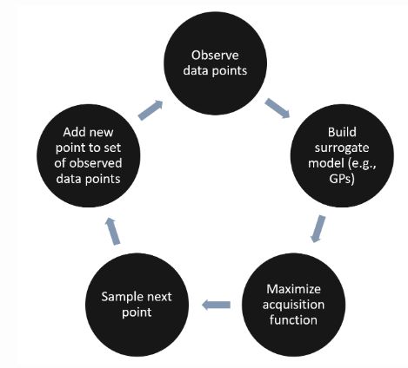
3. Predicting new materials
Trained a RF regression model on the second dataset . RMSE = 10.3
We decide to use Bayesian Optimization to efficiently explore and optimize compositions.
We defined a binary search space to represent the presence (1) or absence (0)
of each element in the composition.
H | Al | Ar
0.5 | 0 | 3
e.g.
…
[1,0,1…]

Slide 12
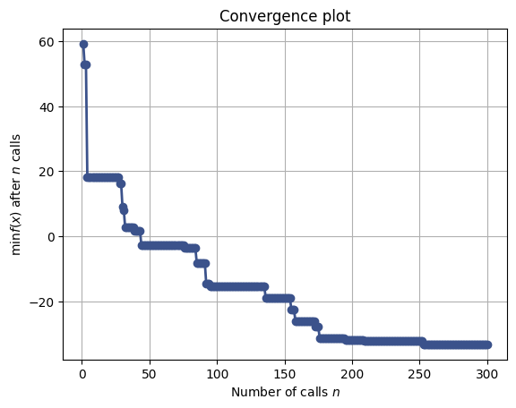
3. Predicting new materials
Constraints in the objective function to ensure realistic results:
limiting element count (max: 4 and then max: 3)
requiring a transition metal.
First attempt: 300 iterations
Second attempt : 180 iterations

Slide 13
3. Predicting new materials
Predicted materials :
Chemical Formula of Optimal Material: | Predicted Tc (K):
H Al Ar Mo | 33.24663
He Mn Zn | 32.10313

Slide 14
Conclusions
We developed an accurate model for estimating Tc while optimizing computational efficiency by identifying the most impactful features.
We uncovered potential anomalies, providing deeper insights into the unique nature of superconductivity.
We predicted new potential combinations of elements that could exhibit relatively High Tc yet to be researched (patent pending….)

